Slide 1

School of Mechanical Engineering
Course Code: BME01T1001 Course Name: Engineering Graphics and Introduction to Digital Fabrication
Introduction to Engineering Graphics
Faculty Name: Mr. Shrikant Vidya Program Name: B.Tech First Year

Slide 2
Prerequisite/Recapitulations
Mathematics
Drawing, Sketching

Slide 3
Objectives
To acquire knowledge about:
Introduction to Product Design
Engineering Graphics in Design Process
Drawing /Graphics vs. Engineering Drawing/Graphics
Drawing Instruments & Materials
Drawing Standards
Drawing Sheets
Layout of Drawing Sheets
Drawing Scales
Drawing Pencils
Types of Lines
Units of Measure
Dimensioning

Slide 4




Product Design
Deals with the conversion of ideas into reality in the form of product .
Aims to fulfill human needs
Product development is set of activities beginning with the perception of market opportunity and ending in the production , sale and delivery of product

Slide 5
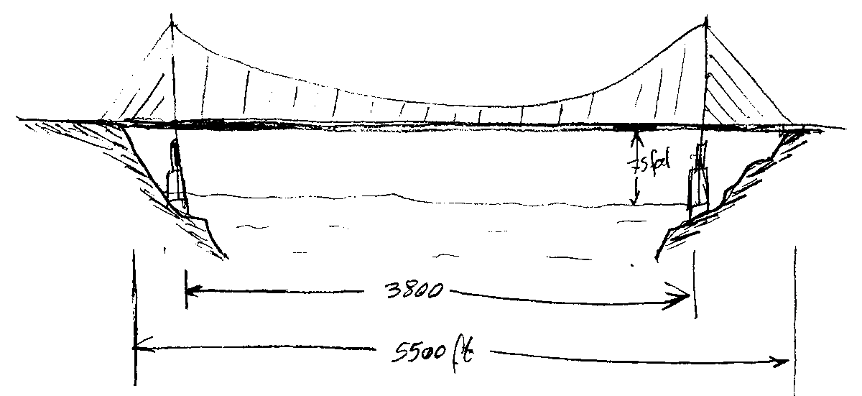
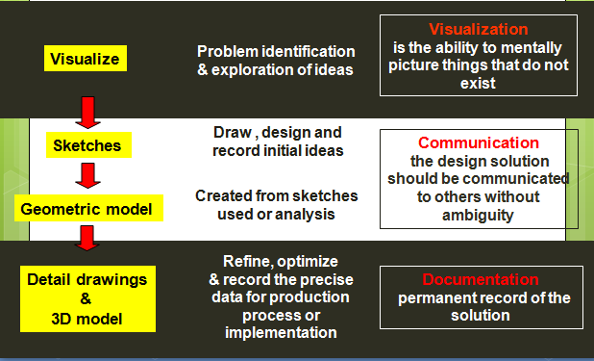


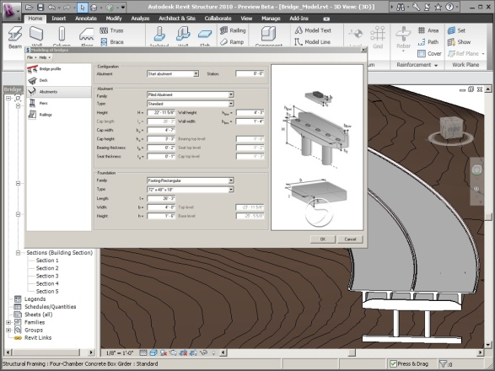
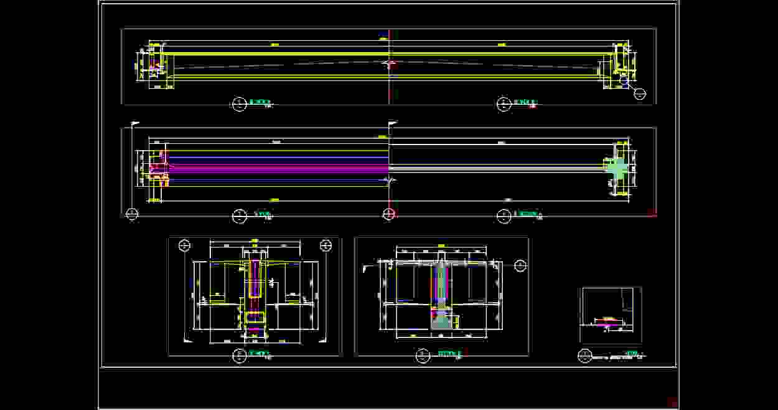

Engineering Graphics In Design Process

Slide 6
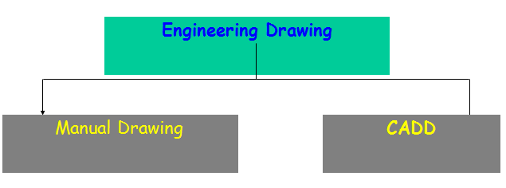
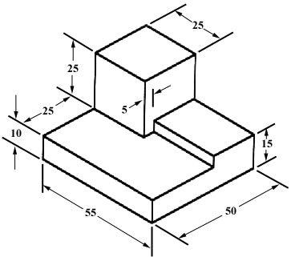
Drawing /Graphics vs. Engineering Drawing/Graphics
Drawing
Describing any object/ information diagrammatically
Graphical representation of an object
Engineering Drawing
Graphical means of expression of technical details without the barrier of a language.
Universal language for engineers
A drawing of an object that contains all information like actual shape, accurate size, manufacturing methods, etc., required for its construction.
No construction/manufacturing of any (man -made) engineering objects is possible without engineering drawing.

Slide 7

Video for Visualization

Slide 8
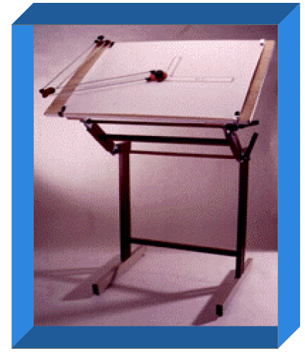
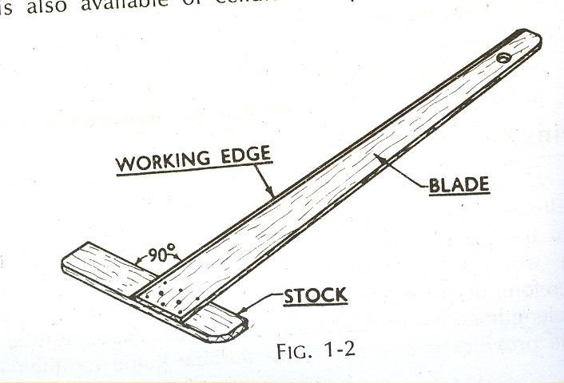
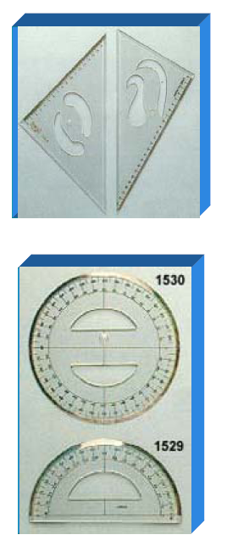
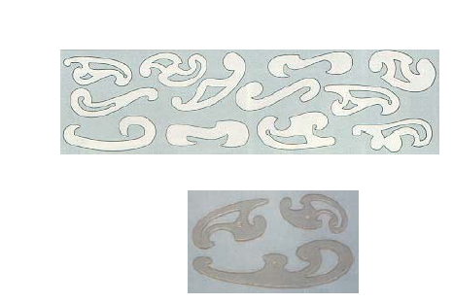

Drawing Instruments & Materials
Drawing board
Drawing sheet
Mini-drafter/drafting machine/ T- square
Instrument box containing compass, divider, etc.
Scales
Protractor
French curves
Drawing pencils
Eraser
Drawing clip/pin/adhesive tape
Sharpener
Duster

Slide 9
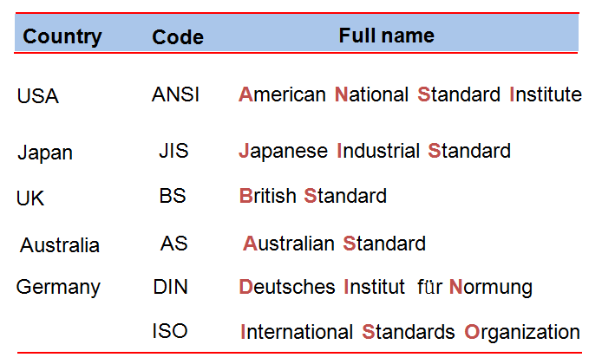
Drawing Standards
Drawing standards are set of rules that govern how technical drawings are represented
Drawing standards are used so that drawings convey the same meaning to everyone who reads them.
Standard Code

Slide 10
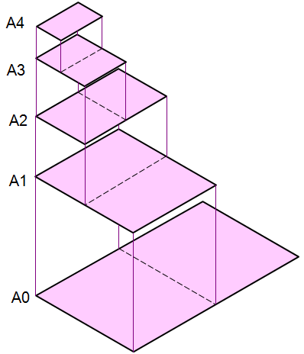
Drawing Sheets
Trimmed paper of a size A0 ~ A4.
Standard sheet size (JIS) A4 210 x 297
A3 297 x 420
A2 420 x 594
A1 594 x 841
A0 841 x 1189
(Dimensions in millimeters)

Slide 11
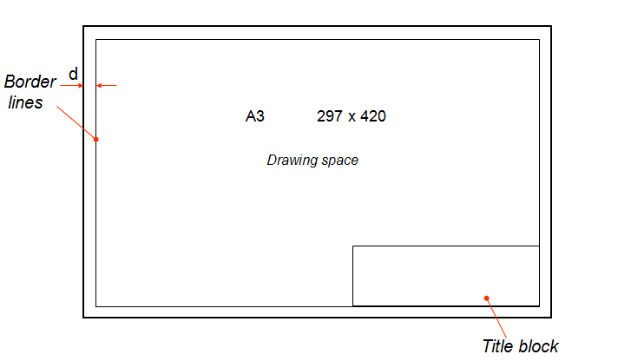
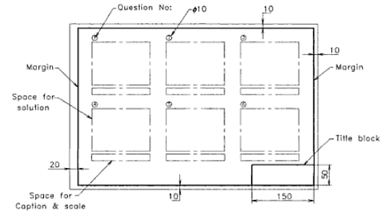
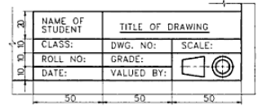
Layout of Drawing Sheets

Slide 12
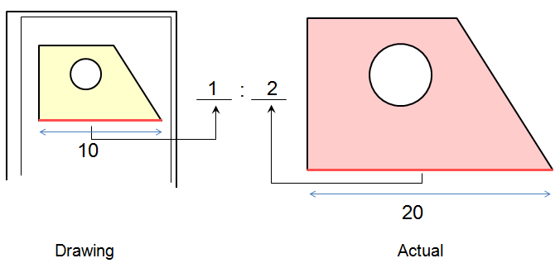
Drawing Scales
Scale is a ratio between the linear dimension of a drawn representation of an object and the actual object.
Designation of a scale consists of the word “SCALE” followed by the indication of its ratio, as follows
SCALE 1:1 for full size
SCALE X:1 (X > 1) for an enlargement scales
SCALE 1:X (X > 1) for a reduction scales
Drawing scale is commonly found in a title block
Standard reducing scales are: 1:5, 1:10, 1:20, 1:50, 1:100
Standard enlarging scales are: 2:1, 5:1, 10:1, 20:1, 50:1, 100:1

Slide 13
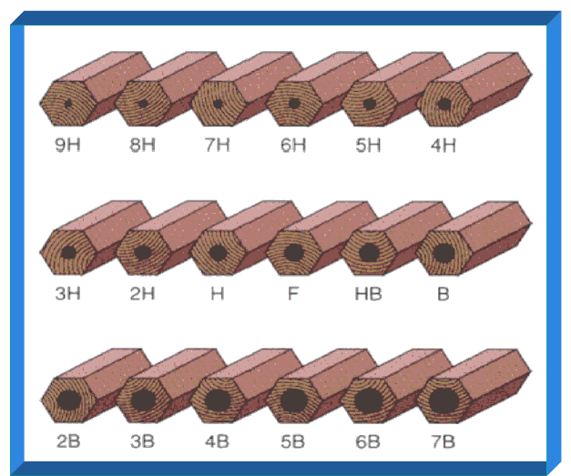
Drawing Pencils
Wooden pencils – are graded and designated by numbers and letters
Mechanical clutch pencils – Not allowed
• 7B, 6B, 5B, 4B, 3B, 2B, B - in decreasing order of softness and blackness
• HB to F – Medium grade
• H, 2H, 3H, 4H, 5H, 6H, 7H, 8H, 9H – increasing order of hardness
Drawings are done using 2H pencils and finished with H and HB pencils – to be practiced in this course.

Slide 14
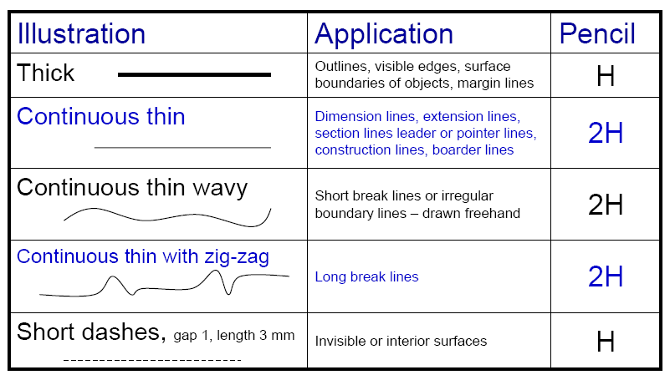
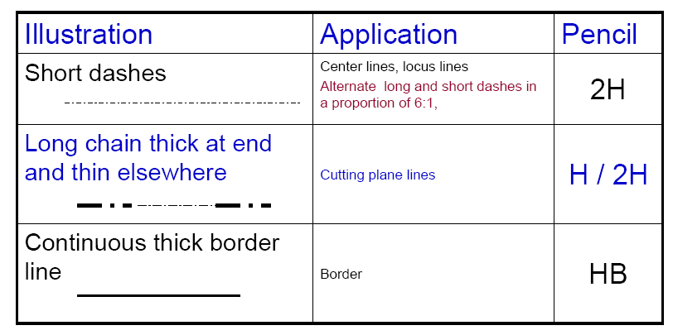
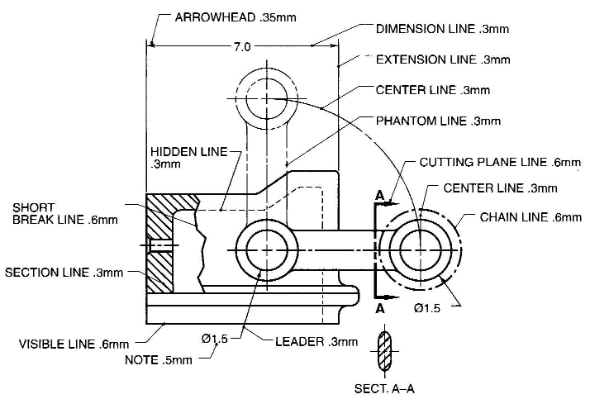
Types of Lines

Slide 15
Units of Measure
International systems of units (SI) – which is based on the meter.
Millimeter (mm) - The common SI unit of measure on engineering drawing.
Individual identification of linear units is not required if all dimensions on a drawing are in the same unit (mm).
The drawing shall however contain a note:
ALL DIMENSIONS ARE IN MM. (Bottom left corner outside the title box)
ALL DIMENSIONS ARE IN MM

Slide 16
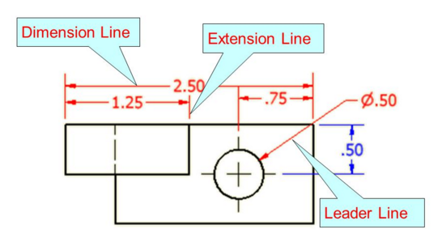
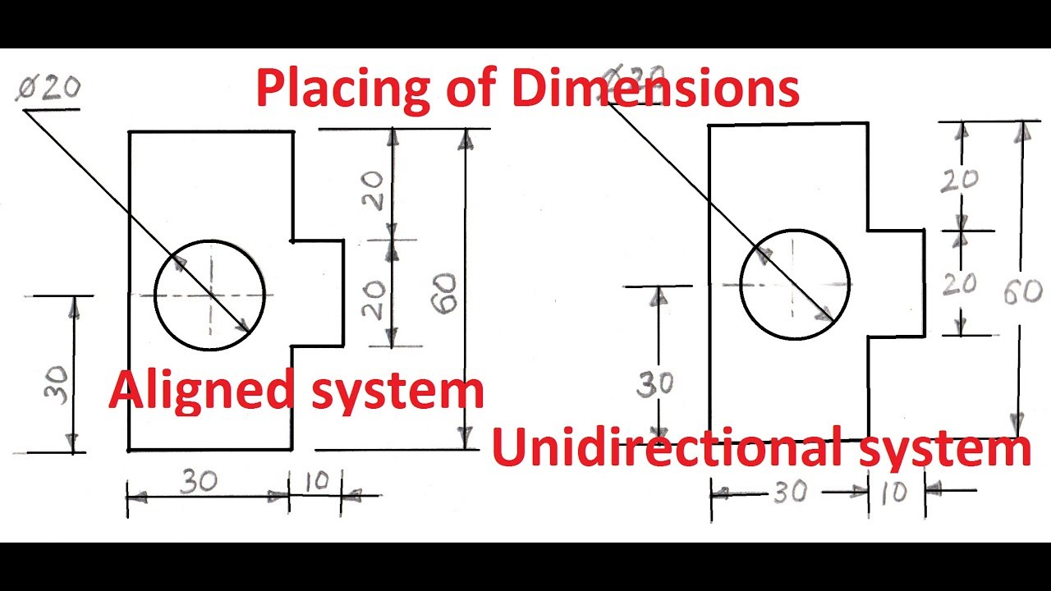
Dimensioning
Dimensioning of an object is accomplished by dimensioning each element to indicate its size (size dimensions) and relative location (location dimensions) from a center line, base line or finished surface.

Slide 17
Summary
An engineering drawing helps to convey ideas and convert concepts into reality
An engineering drawing follows criteria and conventions to eliminate confusion by the standardization of nomenclature and practices, as a way to clearly relay the information to the individual who understands it when it is read, and very importantly, it indicates or hints how something is going to be manufactured.

Slide 18
Questions
How do you explain engineering drawings?
What are the 4 basic components of dimensioning in engineering drawing?
Is Representative Factor (RF) and Scale Factor same?

Slide 19
References
Engineering Drawing by N. D. Bhatt and V. M. Panchal
Engineering Graphics by K. C. John
NPTEL

Slide 20
Thank You

